Slide 1
Azure Storage
Notes:
To get started, let’s take an overview look at Azure Virtual Machines.

Slide 2
Core infrastructure
Compute
Storage
Networking
Management
Virtual machines
Availability sets
VM scale sets
Controlled maintenance
Disks Blob storage File sync
Hot and cold
Virtual networks
VPN, ExpressRoute
Load balancer
DNS, Traffic Manager
Log Analytics
Cloud Shell
Site Recovery
Security Center
Notes:
aking a deeper look at some of the key services that constitute Azure IaaS. We will go into a little bit more detail into each of these services
The four core technologies are Compute, Network, Storage and Management
Compute:
Virtual Machines is no different from the Virtual Machines you run on premise
We will go into the concept of Availability sets that provides you better availability on the platform. Create available solutions. 99.95%
- VM Scale sets, for autoscaling. VM extensions – custom run scripts
Network:
Virtual network similar to on-prem allow VMs to connect on a private network in the cloud. It provides an isolated and secure environment for your applications.
We have different types of connectivity – IPSec VPN or ExpressRoute (private network on a telecom provider, highest level of security)
Bring your own network to Azure, most of the networking technologies you are familiar with are available on Azure
There are different ways to connect to Azure such as VPN, ExpressRoute that we will talk about
We will also talk about features like Load balancing, DNS
What does Traffic manager do – distribute traffic
Storage:
Azure Storage offers different sets of storage services for various business needs. Some of them being disks connecting to a VM or Blob storage for unstructured data
VMs connect to Disks – there are different options Standard or Premium disks based on whether you want higher throughput and lower latency
We have object storage for your storage needs. We recently launched also Cool storage if you don’t need frequent access
Management
Management across the these various foundational services. Some of the services including portal, AD, MFA, Keyvault, marketplace.
Security
AD for identity management
ARM management, powerful – templatized
We’re excited to announce the availability of a new planned maintenance experience in Azure, providing you more control, better communication, and better visibility. While most planned maintenance is performed without any impact to your virtual machines using memory preserving maintenance, some do require a reboot to improve reliability, performance, and security.
What’s new?
More control: You now have the option to proactively initiate a redeploy of your VMs on your schedule within a pre-communicated window, ensuring that planned maintenance will be performed when it is most convenient for you.
Better communication: We added planned maintenance to the Azure Monitor experience where you can create log-based alerts. With Azure Monitor notifications, you can add multiple email recipients to maintenance alerts, receive SMS messages, and configure webhooks, which integrate with your third-party software, to alert you of upcoming maintenance.
Better visibility: We recently introduced Azure Service Health in the Azure Portal, which provides you planned maintenance information at the VM level. Additionally, we introduced Scheduled Events, which surfaces information, including upcoming planned maintenance, via REST API in the VM. You can use this capability as part of maintenance preparation. Lastly you can view upcoming maintenance information via PowerShell and CLI.

Slide 3
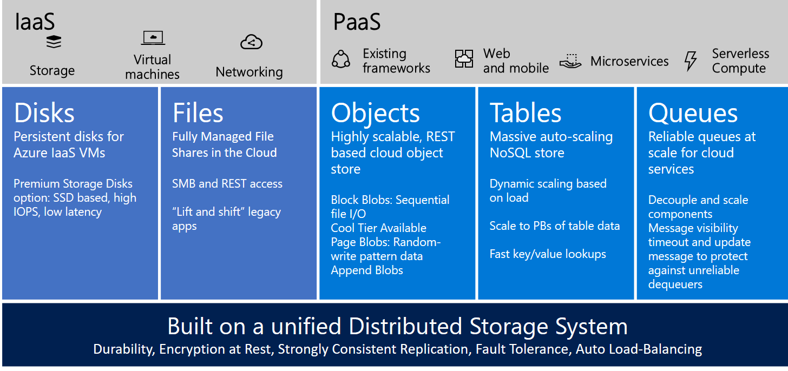
Azure Storage Services

Slide 4
Secure, scalable and highly available storage options for every use case
Disk Storage
Object Storage
File storage
Premium
Standard
Azure Blobs
Azure Files
Azure NetApp Files
Reliable, persistent, high performing storage for Virtual Machines
Secure, centralized storage target for backup/disaster recovery
Lift and shift of legacy applications that require file shares to the cloud
Data Transport
Hybrid Storage
Azure Import/Export
Azure DataBox
Azure StorSimple
Azure File Sync
Move or migrate data into Azure
Secure, intelligent data tiering between on-premises and cloud storage
Notes:
Azure IaaS is designed for high-end workloads and will automatically scale up or down to 1000 instances
Azure has all the power & flexibility of a Virtual Machine:
Minimal learning curve for existing virtualization pros
Run most Windows or Linux-based workloads
Easiest target for migrating to the cloud
Flexible instance sizes—use the best fit for your workload
Advanced networking and storage capabilities
Per second billing with pay-as-you-go billing (or RI)
For existing virtualization pros, the learning curve is minimal as Azure runs on most Windows or Linux-based workloads
Virtual Machines offer advanced networking & storage capabilities
Virtual Machine Scale Sets:
All of the power and flexibility of a Virtual Machine
Designed for high-end workloads
Automatically scale up (or down) to 1000 instances
Availability Sets:
Disks: Persistent, secured disk storage for Azure Virtual Machines
Simple scaling on demand lets you create thousands of disks simultaneously in minutes
Industry-leading durability and availability simultaneously replicates your data to three different replicas.
Offers you more security with granular access control
Lets you easily migrate in minutes
Multiple storage options available

Slide 5
Azure Storage Durability
Typically >300mi
Typically >300mi
Async
Async
Primary
Secondary
Primary
Secondary
LRS
3 replicas, 1 region
Protect against disk, node, rack failures
Write is ack’d when all replicas are committed
Superior to dual-parity RAID
GRS
6 replicas, 2 regions (3/region)
Protects against major regional disasters
Asynchronous to secondary
RA-GRS
GRS + Read access to secondary
Separate secondary endpoint
RPO delay to secondary can be queried

Slide 6
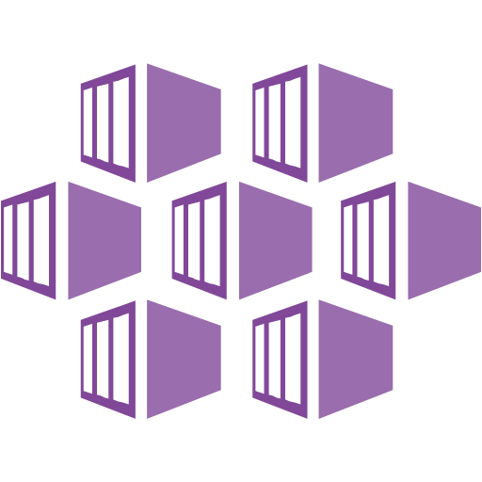










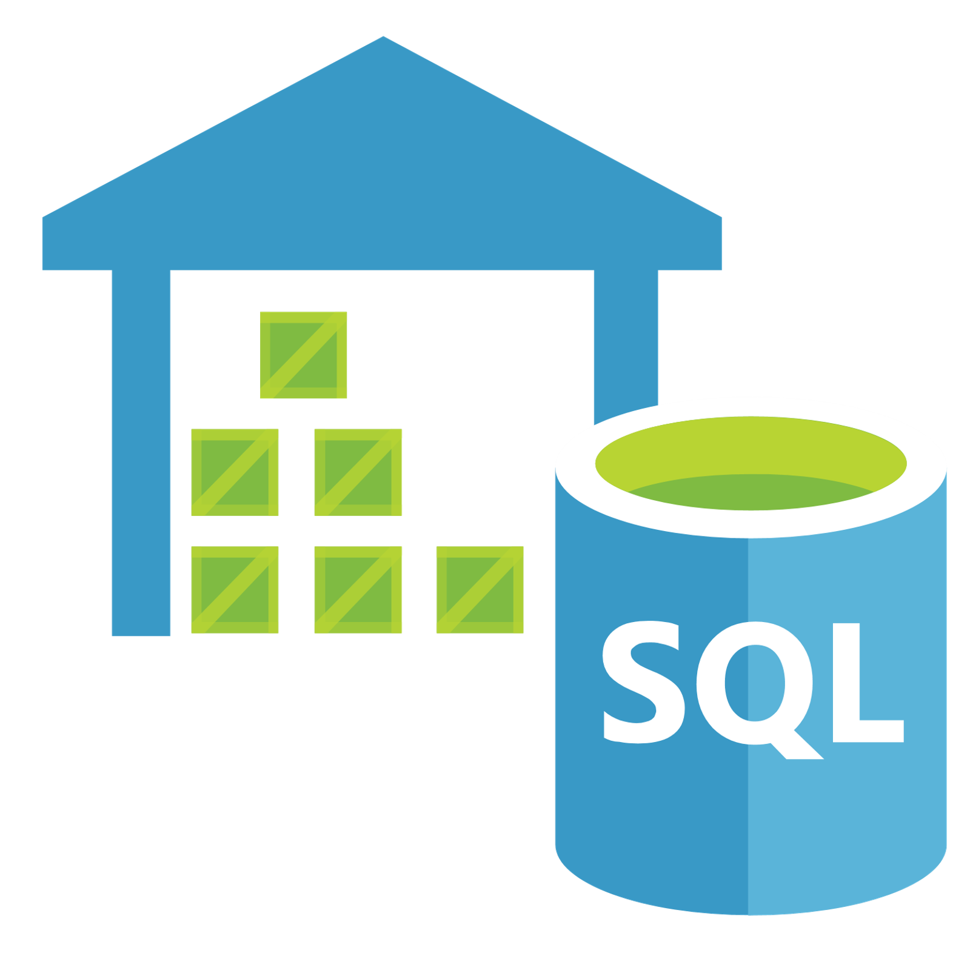



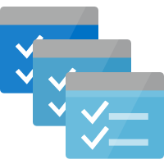

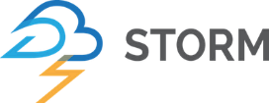
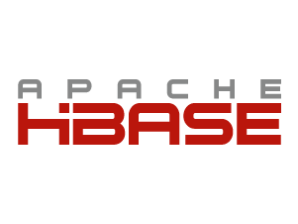






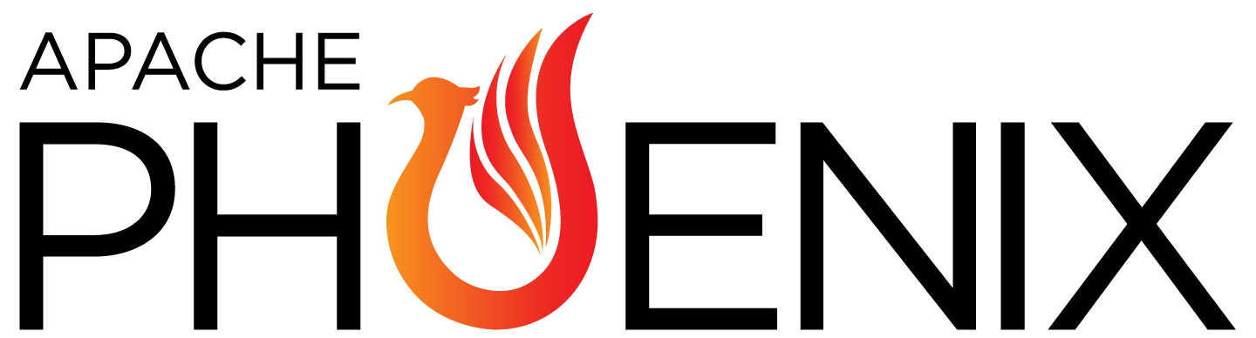
Contemporary Cloud Data Lake
Big Data Use Cases
Ingest & ETL | Streaming | Analytics & Machine Learning | Data Aggregation | Presentation
Monitor
Event Hubs
Functions
Container
Service
App Insights
Log Analytics
Stream Analytics
Machine
Learning
Search
Power BI
Data Lake Analytics
Data Warehouse
IoT Hub
CDN
Data Factory
Batch
Azure HDInsight
Blob Storage
Storage Qualities
Open & Interoperable | Manageable & Cost Efficient | Scalable & Performant | Secure & Compliant | Durable & Available

Slide 7





Azure Data Lake Storage Gen2
A “no-compromises” Data Lake: secure, performant, massively-scalable Data Lake storage that brings the cost and scale profile of object storage together with the performance and analytics feature set of data lake storage
SECURE
MANAGEABLE
FAST
SCALABLE
COST EFFECTIVE
INTEGRATION READY
Support for fine-grained ACLs, protecting data at the file and folder level
Multi-layered protection via at-rest Storage Service encryption and Azure Active Directory integration
Automated Lifecycle Policy Management
Object Level tiering
Atomic file operations means jobs complete faster
No limits on data store size
Global footprint (50 regions)
Object store pricing levels
File system operations minimize transactions required for job completion
Optimized for Spark and Hadoop Analytic Engines
Tightly integrated with Azure end to end analytics solutions

Slide 8

Azure Data Lake Storage Gen2
ADLS Gen2 adds a high performance HDFS Endpoint to Azure Blob Storage and inherits the rich feature set of Azure Blob Storage *
Blob API
Gen2 API
Unstructured Object Data
File Data
Server Backups, Archive Storage, Semi-structured Data
Hadoop File System, File and Folder Hierarchy, Granular ACLS Atomic File Transactions
Common Blob Storage Foundation
Object Tiering and Lifecycle Policy Management
AAD Integration, RBAC, Storage Account Security
HA/DR support through ZRS and RA-GRS
* Full Blob and HNS Interoperability available in post-GA

Slide 9



ADLS Gen2 key audiences & benefits
Data Engineer
Data Scientists
CDO, VP of analytics
Supports familiar REST API and HDFS file system
Integration with leading Hadoop and Spark analytic engines like Databricks
Low Cost Storage for structured and unstructured data
Strong analytics ISV support
Granular file and folder level security
Supports Azure Active Directory Integration and other advanced security features available in Blob Storage
Fast performance leads to lower end to end analytic job run times
Integration with leading Hadoop and Spark analytic engines like Databricks
Supports integration with visualization tools like Power BI and Tableau
Granular file and folder level security
Low Cost Storage for structured and unstructured data
Meets data sovereignty requirements in multiple geographies
Granular file and folder level security
Supports Azure Active Directory Integration and other advanced security features available in Blob Storage
Inherits object level tiering and advanced HA/DR capabilities of Blob Storage

Slide 10
Big data & Data warehouse
LOB
CRM
INGEST
STORE
PREP & TRAIN
MODEL & SERVE
BI + Reporting
Graph
Advanced Analytics
Image
Social
Data orchestration and monitoring
Big data store
Analytics engines
Data warehouse
Real Time Analytics
IoT
Cloud

Slide 11

Big Data & Advanced Analytics at a glance
Ingest
Store
Prep & Train
Model & Serve
Intelligence
Business apps
Data Factory
(Data movement, pipelines & orchestration)
Cosmos DB
Predictive apps
Azure Data Lake Storage
Databricks
HDInsight
Data Lake Analytics
SQL
Custom apps
Kafka
10 01
SQL Database
SQL Data Warehouse
Operational reports
Event Hub
IoT Hub
Machine Learning
Sensors and devices
Analysis Services
Analytical dashboards
Notes:
Azure build-out of DMSA. Supports hybrid\on-premises too through ADF \ Blob \ Stretch.

Slide 12

Q & A

